Slide 1
Twitter’s Recommendation Algorithm
By Team 13: Garrett Stephens, Lingli Jin, Michael Morris, Rohit Vadodaria

Slide 2
Agenda
Problem Statement
The Algorithm
Research Paper
Code from Twitter Algorithm GitHub
Related Issues

Slide 3
Problem Statements
What problem does the Twitter algorithm solve in the For You Page?
How does the algorithm work to suggest personalized content to users?
How can users influence their feed, and how are tweets from verified users weighed?
What are the potential concerns about the algorithm's impact on society?

Slide 4
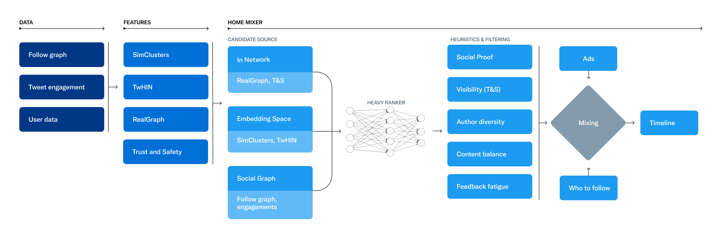
Twitter’s Recommendation Algorithm
Twitter's Recommendation Algorithm

Slide 5
SimClusters: Community-Based Representations for Heterogeneous Recommendations at Twitter
Community-based approach is more effective than existing methods to make heterogeneous recommendations on Twitter
Introducing SimClusters
User-to-user graph-based clustering
Users and items are represented as vectors
Key to discovery is use of Neighborhood-aware Metropolis-Hastings
Iteration of MH algorithm that takes into account local node and global graph structure
10x-100x faster, 3x-4x more accurate
Scales easily to billions of nodes and edges
SimClusters: Community-Based Representations for Heterogeneous Recommendations at Twitter

Slide 6
SimClusters: Community-Based Representations for Heterogeneous Recommendations at Twitter
Other aspects of SimClusters:
Universal representations of content
Very accurate beyond popular content due to scalability
Design accommodates dynamic items with high churn rate
Applications
Home page tweet engagement increased by 33%
Trend engagement increased by 8%
Follow rate increase of 7%
SimClusters: Community-Based Representations for Heterogeneous Recommendations at Twitter

Slide 7


SimClusters
Where tweet characteristics are represented as vectors to feed recommender systems.
Users and tweets represent communities
Goal: “Calculate the similarity between any two users, Tweets or user-Tweet pairs in this embedding space” to provide the user with similar and relevant tweets of other users to interact with.
Group B
Group A
Twitter's Recommendation Algorithm

Slide 8
SimClusters - Main Steps
This store looks for tweets whose similarity is close to a Source SimClustersEmbeddingId.
Approximate cosine similarity is the core algorithm to drive this store.
Step 1 - 4 are in "fetchCandidates" method.
1. Retrieve the SimClusters Embedding by the SimClustersEmbeddingId
2. Fetch top N clusters' top tweets from the clusterTweetCandidatesStore (TopTweetsPerCluster index).
3. Calculate all the tweet candidates' dot-product or approximate cosine similarity to source tweets.
4. Take top M tweet candidates by the step 3's score
the-algorithm/ApproximateCosineSimilarity.scala at main · twitter/the-algorithm (github.com)

Slide 9
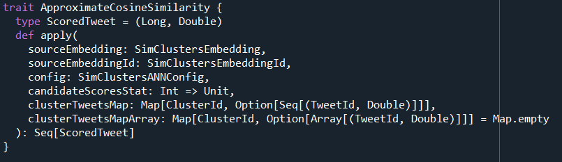
SimClusters - Step 1
Retrieve the SimClusters Embedding by the SimClustersEmbeddingId
the-algorithm/ApproximateCosineSimilarity.scala at main · twitter/the-algorithm (github.com)

Slide 10
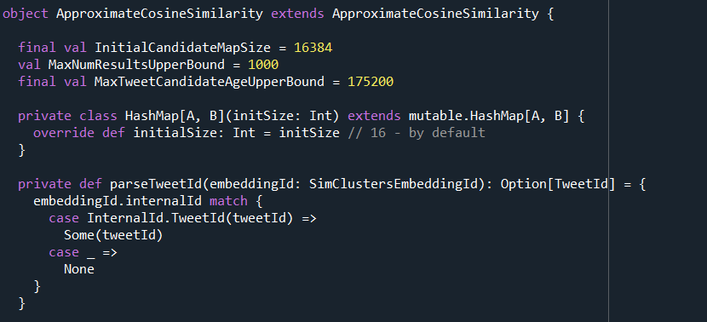
SimClusters - Step 2
Fetch top N clusters' top tweets from the clusterTweetCandidatesStore (TopTweetsPerCluster index).
the-algorithm/ApproximateCosineSimilarity.scala at main · twitter/the-algorithm (github.com)

Slide 11
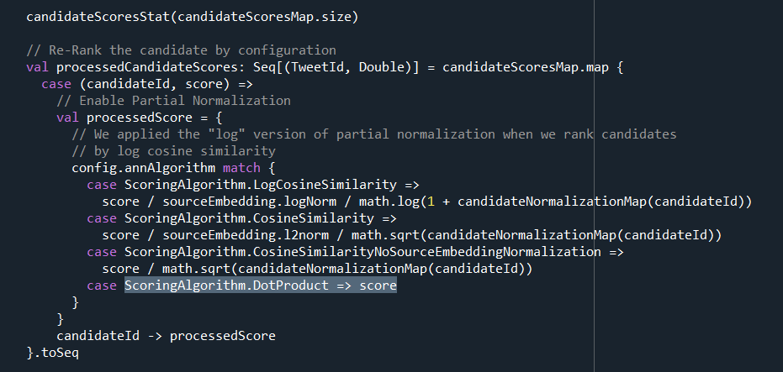
SimClusters - Step 3
Calculate all the tweet candidates' dot-product or approximate cosine similarity to source tweets
the-algorithm/ApproximateCosineSimilarity.scala at main · twitter/the-algorithm (github.com)

Slide 12
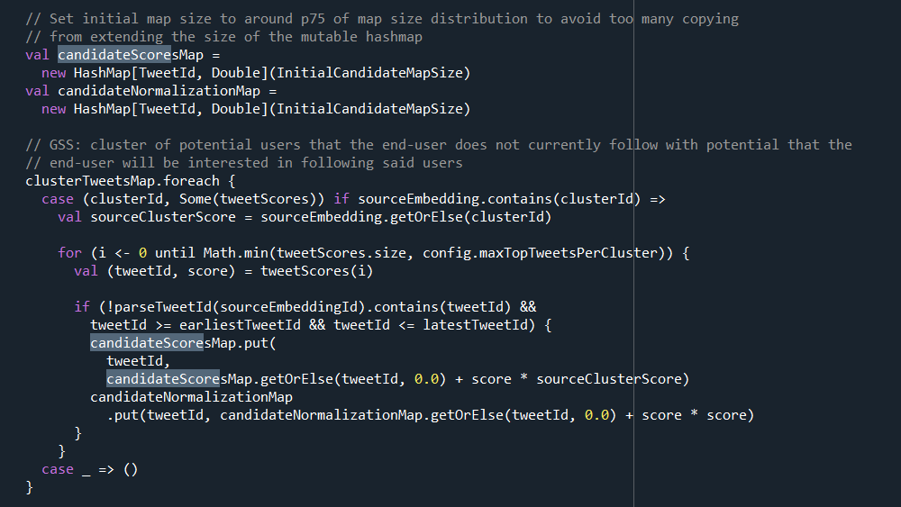
SimClusters - Step 4
Take top M tweet candidates by the step 3's score
the-algorithm/ApproximateCosineSimilarity.scala at main · twitter/the-algorithm (github.com)

Slide 13
Twitter’s Recommendation Algorithm
Twitter's Recommendation Algorithm

Slide 14
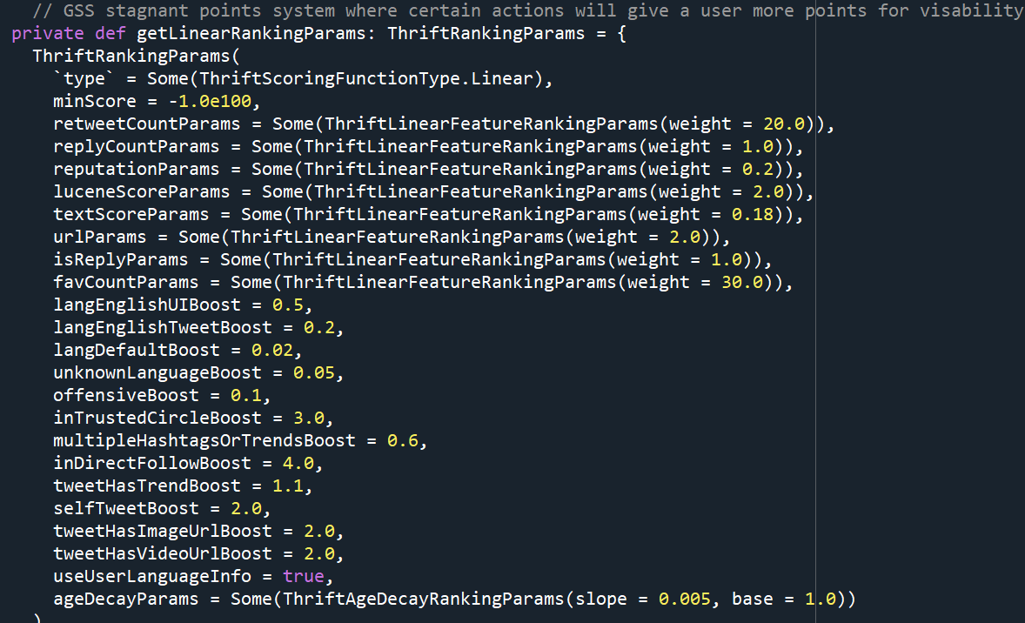
Ranking Points
the-algorithm/EarlybirdTensorflowBasedSimilarityEngine.scala at main · twitter/the-algorithm (github.com)

Slide 15
Ethical Concerns
Explainability: Having the code be open source increases transparency between the company and the end-user.
Ethical: Understanding the algorithm can influence how users tweet – lead to spreading misinformation to increase one’s visibility on the platform.
Bias: If the algorithm was not designed with fairness in mind, it could result in public bias
Privacy: An algorithm using personal data could raise concerns about privacy

Slide 16
Citation Page
Twitter, V. S., Satuluri, V., Twitter, Twitter, Y. W., Wu, Y., University, X. Z. C. M., Zheng, X., University, C. M., Twitter, Y. Q., Qian, Y., Twitter, B. W., Wichers, B., Twitter, Q. D., Dai, Q., Twitter, G. M. T., Tang, G. M., Twitter, J. J., Jiang, J., Waterloo, J. L. U. of, … Venu Satuluri The Ohio State University Publication Years2007 - 2020Publication counts11Available for Download9Citation count512Downloads (cumulative)9. (2020, August 1). Simclusters: Proceedings of the 26th ACM SIGKDD International Conference on Knowledge Discovery & Data Mining. ACM Conferences. Retrieved April 12, 2023, from https://dl.acm.org/doi/pdf/10.1145/3394486.3403370
Twitter. (n.d.). Twitter's recommendation algorithm. Twitter. Retrieved April 12, 2023, from https://blog.twitter.com/engineering/en_us/topics/open-source/2023/twitter-recommendation-algorithm

